Slide 1
AlphaPy
A Data Science Pipeline in Python

Slide 2
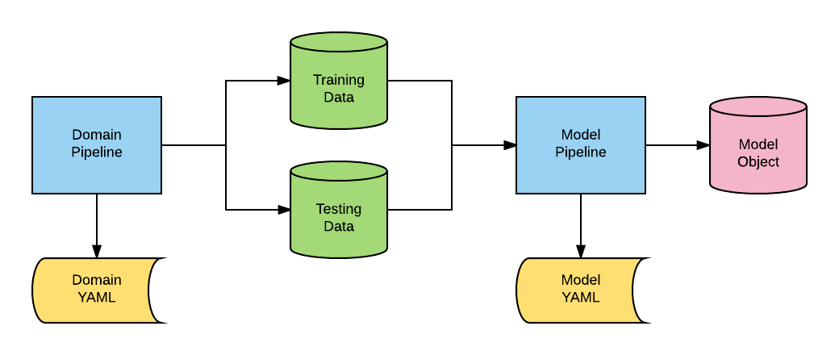
The Framework

Slide 3
The Framework
The Model Pipeline is the common code that will generate a model for any classification or regression problem.
The Domain Pipeline is the code required to generate the training and test data; it transforms raw data from a feed or database into canonical form.
Both pipelines have configuration files using the YAML format.
The output of the whole process is a Model Object, which is persistent; it can be saved and loaded for analysis.

Slide 4
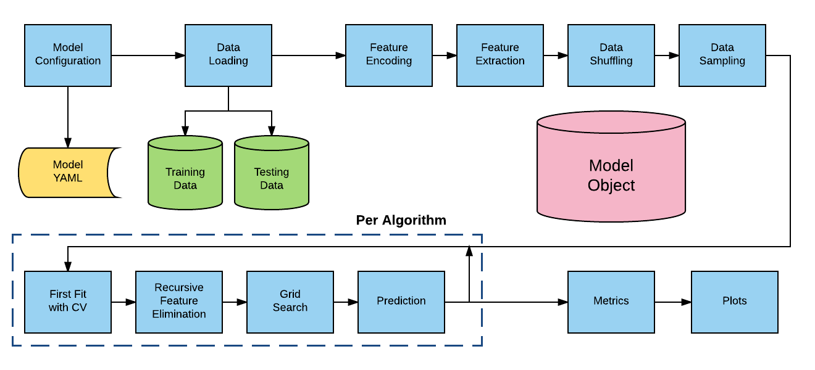
Model Pipeline

Slide 5
Model Pipeline

Slide 6
Components
scikit-learn: machine learning in Python
pandas: Python data analysis library
NumPy: numerical computing package for Python
spark-sklearn: scikit-learn integration package for Spark
skflow: scikit-learn wrapper for Google TensorFlow
SciPy: scientific computing library for Python
imbalanced-learn: resampling techniques for imbalanced data sets
xgboost: scaleable and distributed gradient boosting

Slide 7
Predictive Models
Binary Classification: Classify elements of a given set into two groups.
Multiclass Classification: Classify elements of a given set into greater than two or more groups.
Regression: Predict real values of a given set.

Slide 8
Classification
AdaBoost
Extra Trees
Google TensorFlow
Gradient Boosting
K-Nearest Neighbors
Logistic Regression
Support Vector Machine (including Linear)
Naive Bayes (including Multinomial)
Radial Basis Functions
Random Forests
XGBoost Binary and Multiclass

Slide 9
Regression
Extra Trees
Gradient Boosting
K-Nearest Neighbor
Linear Regression
Random Forests
XGBoost

Slide 10
Data Sampling
Different techniques to handle unbalanced classes
Undersampling
Oversampling
Combined Sampling (SMOTE)
Ensemble Sampling

Slide 11
Feature Engineering
Imputation
Row Statistics and Distributions
Clustering and PCA
Standard Scaling (e.g., mean-centering)
Interactions (n-way)
Treatments (see below)

Slide 12
Treatments
Some features require special treatment, for example, a date column that is split into separate columns for month, day, and year.
Treatments are specified in the configuration file with the feature name, the treatment function, and its parameters.
In the following example, we apply a runs test to 6 features in the YAML file:

Slide 13
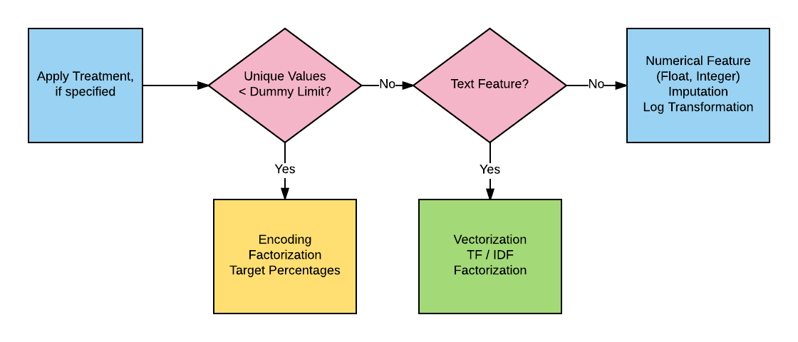
Feature Transformation

Slide 14
Feature Processing

Slide 15
Encoders
Factorization
One-Hot
Ordinal
Binary
Helmert Contrast
Sum Contrast
Polynomial Contrast
Backward Difference Contrast
Simple Hashing

Slide 16
Feature Selection
Univariate selection based on the percentile of highest feature scores
Scoring functions for both classification and regression, e.g., ANOVA F-value or chi-squared statistic
Recursive Feature Elimination (RFE) with Cross-Validation (CV) with configurable scoring function and step size

Slide 17
Grid Search
Full or Randomized Distributed Grid Search with subsampling (Spark if available)

Slide 18
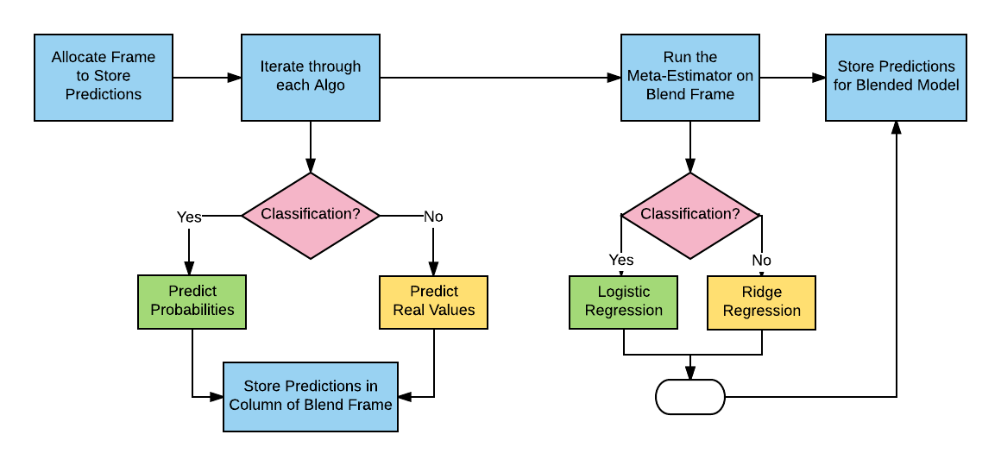
Ensembles Blending and Stacking

Slide 19
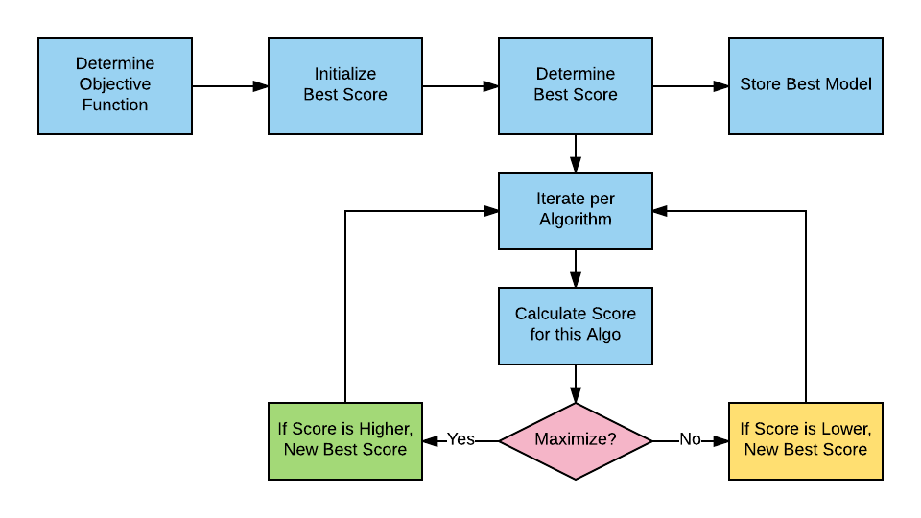
Best Model Selection

Slide 20
Model Evaluation
Metrics
Calibration Plot
Confusion Matrix
Learning Curve
ROC Curve

Slide 21
Metrics

Slide 22
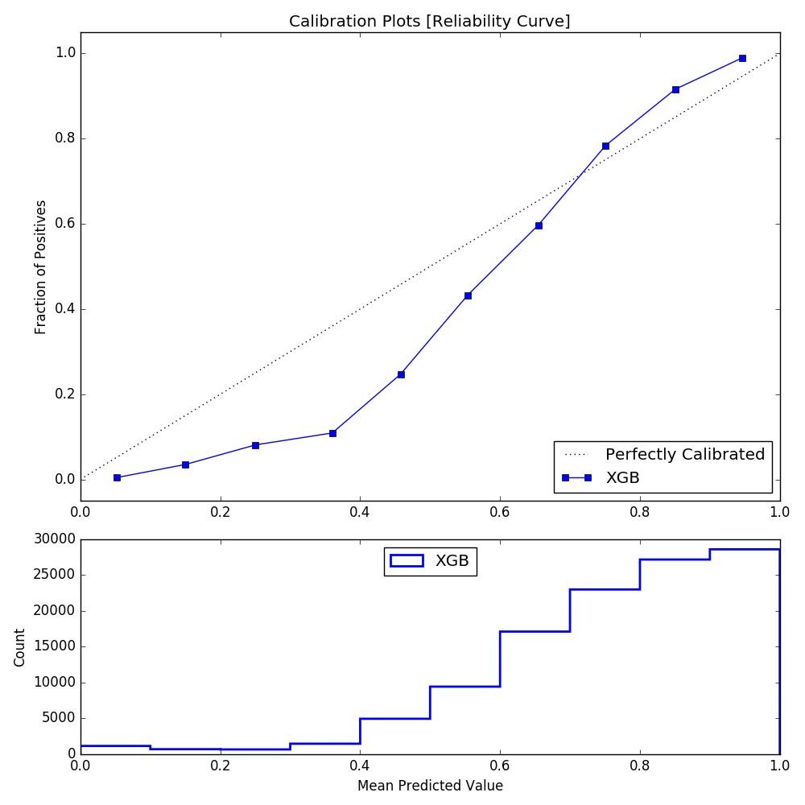
Calibration Plot

Slide 23
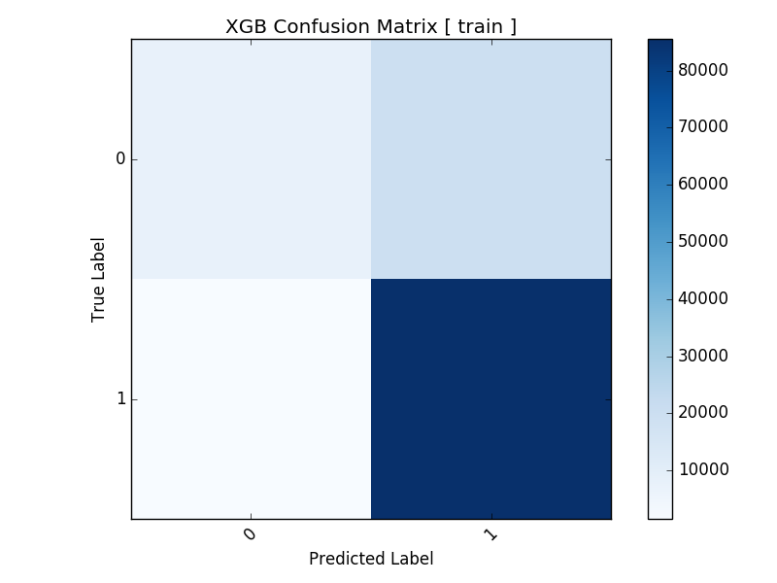
Confusion Matrix

Slide 24
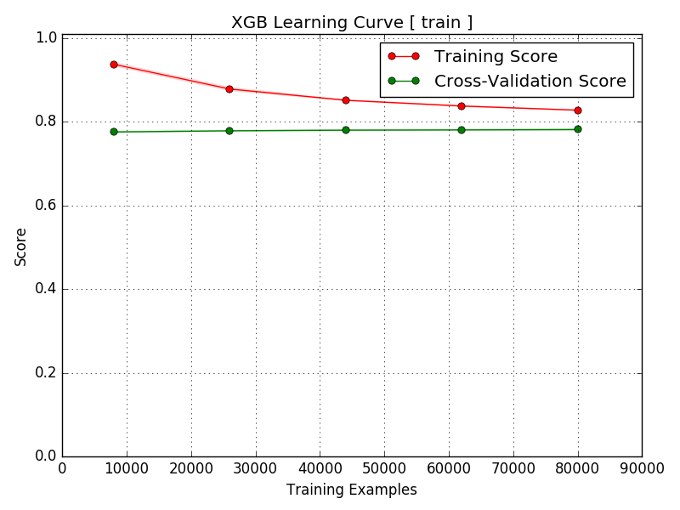
Learning Curve

Slide 25
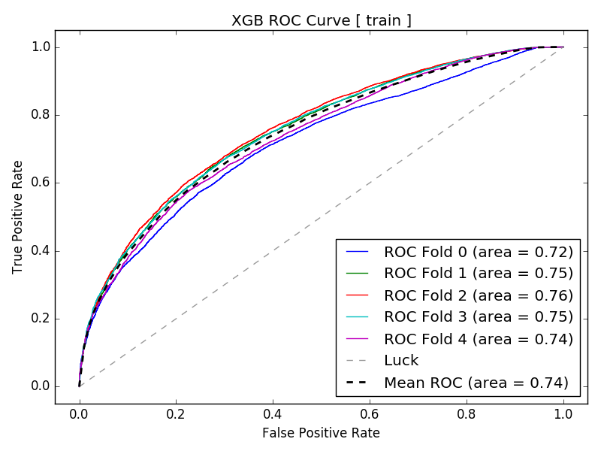
ROC Curve

Slide 26
Domains
A domain encapsulates functionality that operates on specific kinds of schema or subject matter.
The purpose of the Domain Pipeline is to prepare data for the Model Pipeline. For example, both market and sports data are time series data but must be structured differently for prediction.
Market data consist of standard primitives such as open, high, low, and close; the latter three are postdictive and cause data leakage. Leaders and laggards must be identified and possibly column-shifted, which is handled by the Model Pipeline.
Sports data are typically structured into a match or game format after gathering team and player data.

Slide 27
Market Domain
Suppose we have five years of history for a group of stocks, each stock represented by rows of time series data on a daily basis.
We want to create a model that predicts whether or not a stock will generate a given return over the next n days, where n = the forecast period.
The goal is to generate canonical training and test data for the model pipeline, so we need to apply a series of transformations to the raw stock data.

Slide 28
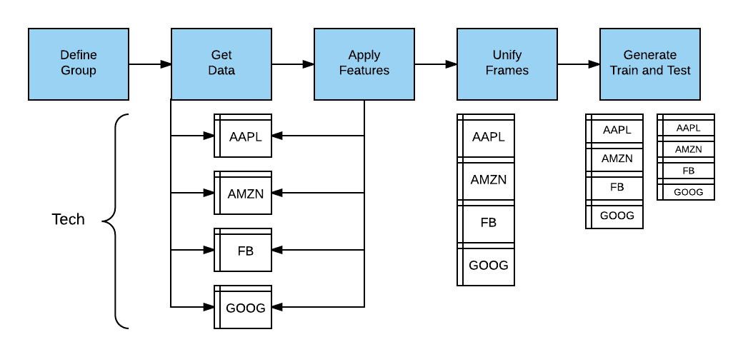
Market Pipeline

Slide 29
Feature Definition Language
Along with treatments, we defined a Feature Definition Language (FDL) that would make it easy for data scientists to define formulas and functions.
Features are applied to groups, so feature sets are uniformly applied across multiple frames.
The features are represented by variables, and these variables map to functions with parameters.

Slide 30
FDL Example
Suppose we want to use the 50-day moving average (MA) in our model, as we believe that it has predictive power for a stock’s direction.
The moving average function ma has two parameters: a feature (column) name and a time period.
To apply the 50-day MA, we can simply join the function name with its parameters, separated by “_”, or ma_close_50.
If we want to use an alias, then we can define cma to be the equivalent of ma_close and get cma_50.

Slide 31
Stock Pipeline Example
Develop a model to predict days with ranges that are greater than average.
We will use both random forests and gradient boosting.
Get daily data from Yahoo over the past few years to train our model.
Define technical analysis features with FDL.

Slide 32
Stocks Configuration

Slide 33
Stocks Configuration

Slide 34
Model Configuration
Data Section

Slide 35
Model Configuration
Model Section

Slide 36
Model Configuration
Features Section

Slide 37
Model Configuration
Other Sections

Slide 38
Start Stocks Pipeline

Slide 39
Get Stock Prices

Slide 40
Apply Variables

Slide 41
Create Train/Test Files

Slide 42
Transform Features

Slide 43
Fit Model

Slide 44
Cross-Validate

Slide 45
Generate Metrics

Slide 46
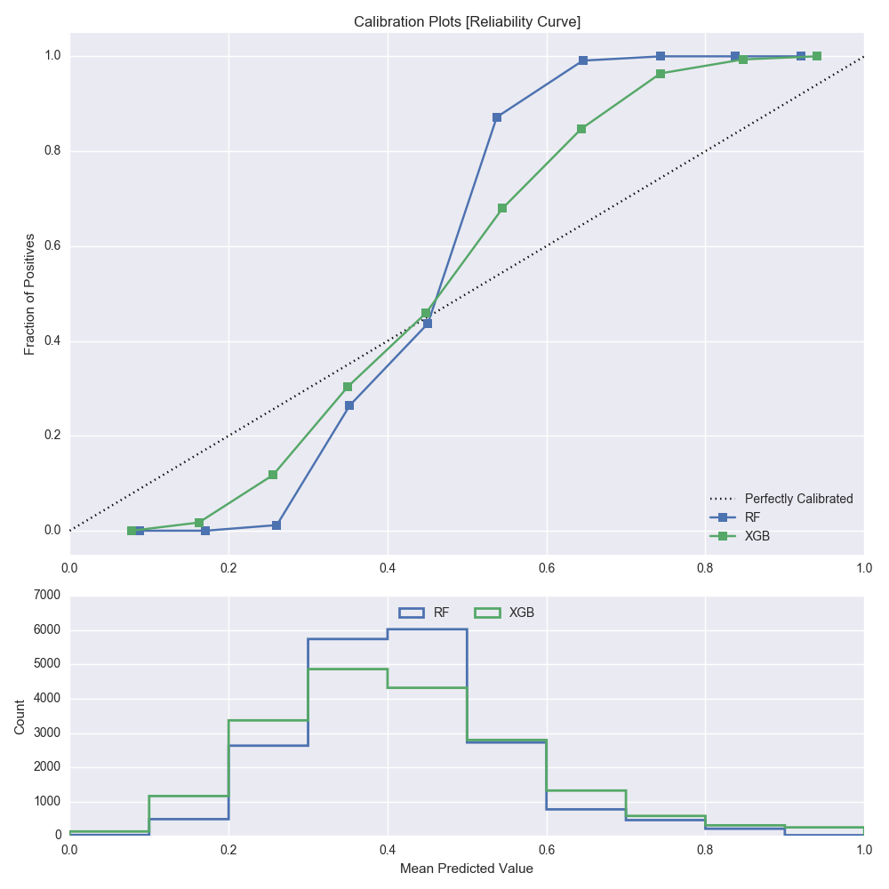
Calibration [Train]

Slide 47
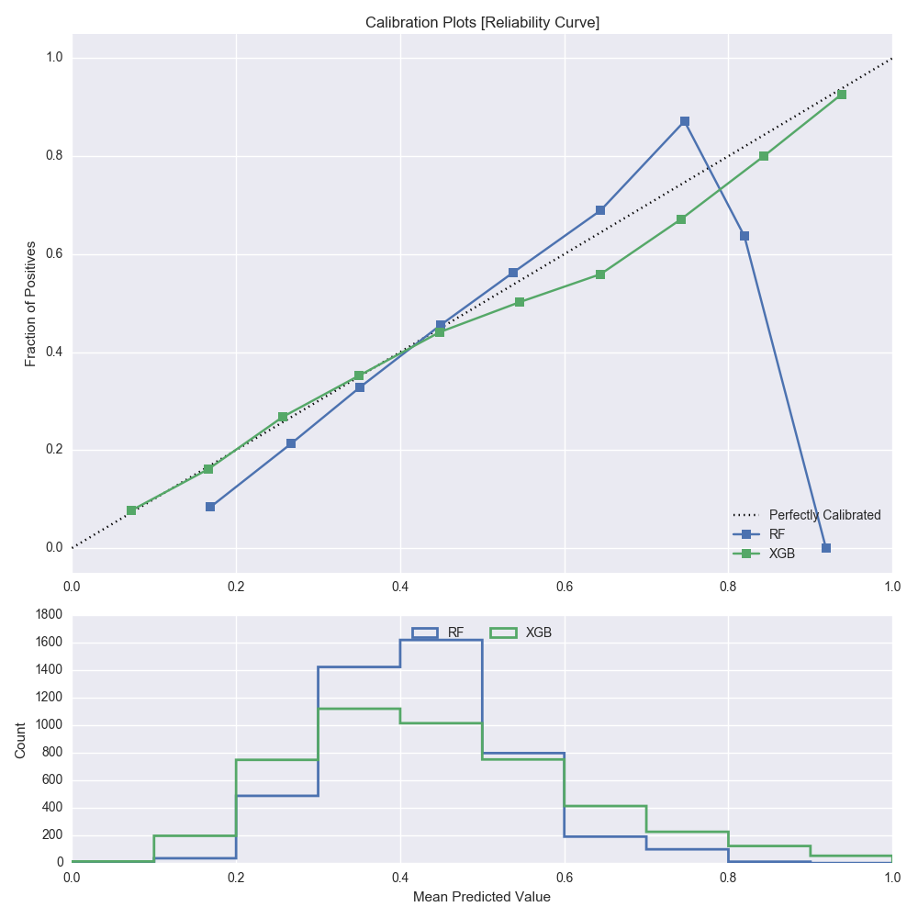
Calibration [Test]

Slide 48
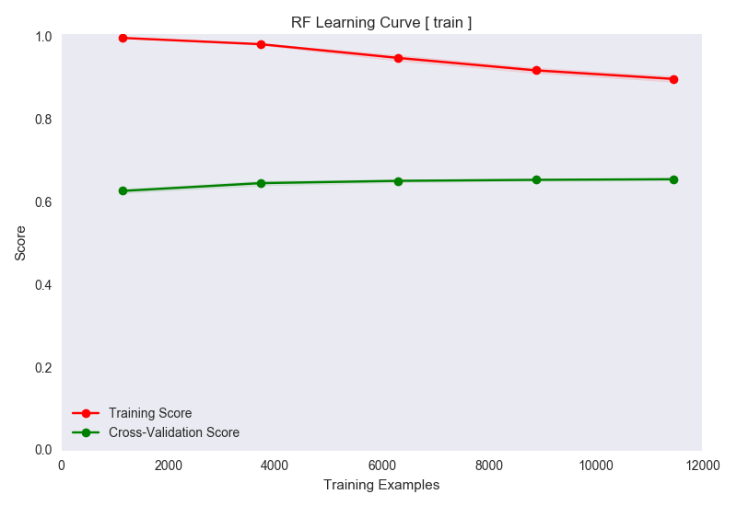
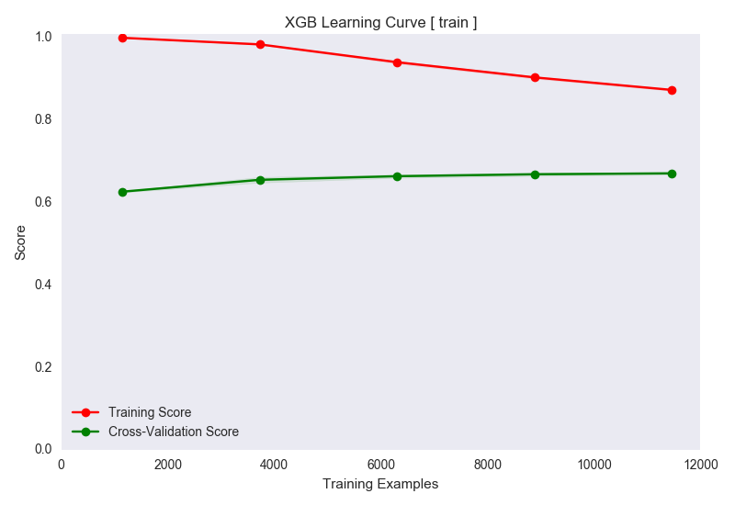
Learning Curves

Slide 49
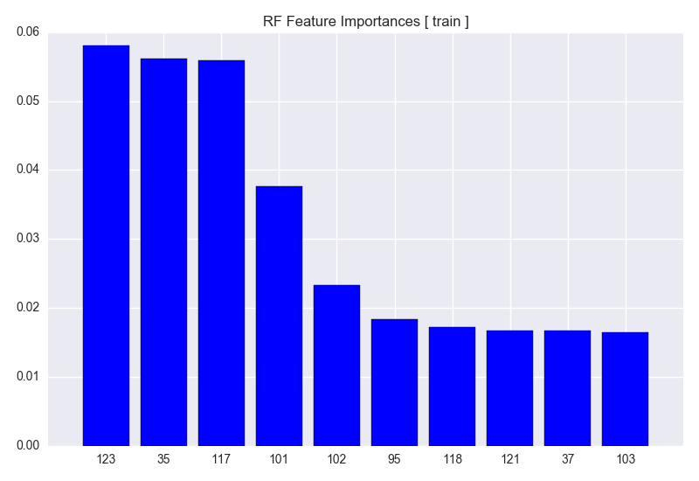
Feature Importances

Slide 50
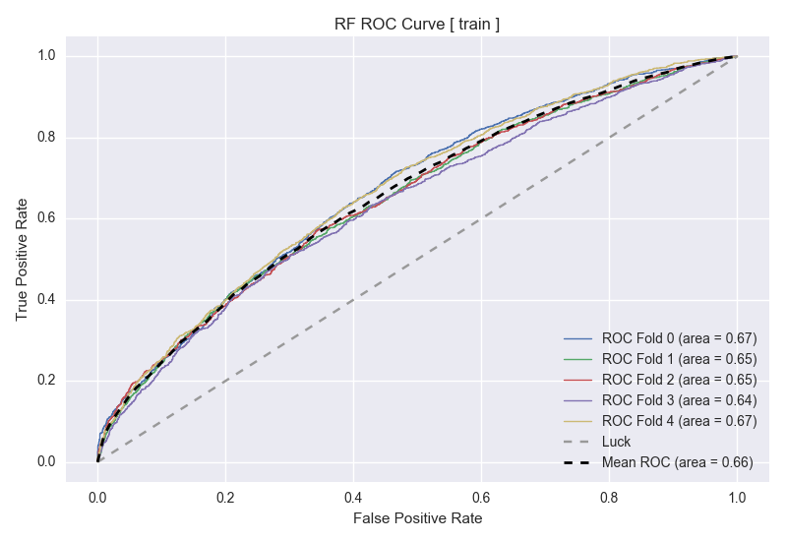
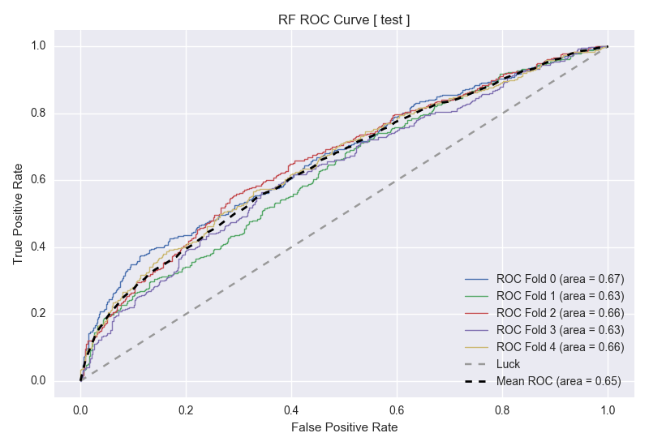
Random Forest ROC

Slide 51
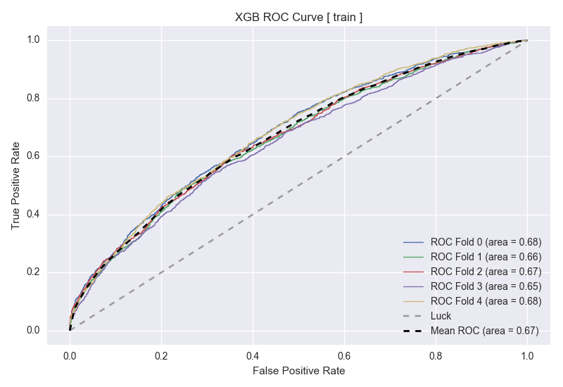
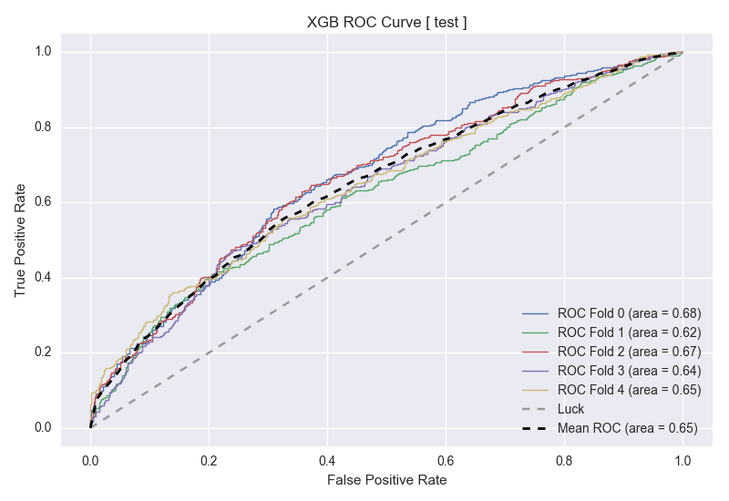
XGBoost ROC

Slide 52
Results
We have identified some features that predict large-range days. This is important for determining whether or not to deploy an automated system on any given day.
Results are consistent across training and test data.
The learning curves show that results may improve with more data.

Slide 53
Use Cases
AlphaPy was created based on experimentation with many Kaggle competitions, so it can generate models for any classification or regression problem.
AlphaPy has been designed to be a toolkit for all data scientists.
The AlphaPy framework has specific pipelines for creating market and sports models.

